Slide 1


HUM 102 Report Writing Skills
Lecture 11

Slide 2

Previous Lecture
The writing process
Pre-writing techniques with examples

Slide 3
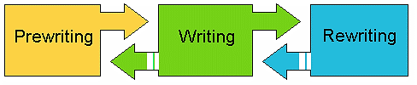

The Writing Process: An Overview
The writing process is recursive.
The three steps are dynamic and overlap.
Improves correspondence and enhances professionalism.

Slide 4

The Writing Process
Three Stages
Pre-writing – Planning
Writing – Drafting
Post-writing – Finishing

Slide 5


Stage 02: Writing
About Writing
Drafting: Compose a draft
Order: The sequence for presenting ideas
Organization of paragraphs
Unity – everything refers back to main point
Support – examples
Coherence – connect to form a whole

Slide 6
Stage 02: Writing
Organize according to some logical sequence which your readers can follow. For Example:
Chronology – good for instructions
Spatial – good for technical descriptions
Importance – good for reports and memos
Problem/Solution – good for proposals
Comparison/Contrast – good for showing alternatives

Slide 7
Stage 02: Writing
Chronological Writing
Method of organization to present events and actions as they occurred in time, e.g., Narrative Essays.
“I woke up in the morning at 08:00 AM. Then, got ready and reached office at 09:30 AM. I collected all the points to discuss them in the meeting at 10:00 AM. The meeting carried on till 01:00 PM. I finally had some time to take my lunch…”

Slide 8
Stage 02: Writing
Spatial Writing
Method of writing in which items are described and explained according to their physical position or relationships, e.g., top to bottom, left to right or even Toyota Corolla.
“3-D floating interior with soft touch padding creates a luxuriously spacious, ergonomic, and prestigious environment.”

Slide 9
Stage 02: Writing
Writing for Importance
To highlight the significance of a subject matter.
“CIIT-pioneered Hybrid Learning is gaining momentum across Pakistan, offering education at par with international standards.”

Slide 10
Stage 02: Writing
Writing for Problem/Solution
To provide solution for a problem.
“Eco-Idle System has been integrated in the modern automobiles to reduce the percentage of Global Carbon Emissions, which are responsible for increasing Green House Effect and, consequently, Global Warming.”

Slide 11
Stage 02: Writing
Writing for Comparison/Contrast
To provide a comparative analysis.
“Uber is comparatively cheaper as compared to Careem and all kinds of automobiles are easily accessible. This is not the case with Careem, as it prefers a Japanese automobile compared to the other common brands in Pakistan.”

Slide 12
Stage 02: Writing
Writing for Clarity
Format the content to allow for ease of access. Use highlighting techniques, such as:
White space
Headings
Bullets
Graphics
Font changes
Color

Slide 13
Stage 02: Writing
Writing a Draft
Draft is a piece of writing which will probably be changed and improved: not the final copy!
The dictionary definition says, “a draft is preliminary piece of writing”.
Writing more than one draft allows you to develop your ideas and to find the best way to present your ideas to your reader.

Slide 14
Stage 02: Writing
Think About How to Generate Your Own Ideas
Ask yourself questions as you experiment with different ways to organize your ideas, such as:
How can I group my ideas in paragraphs?
What is the focus and purpose of each paragraph?
In what order should I present my ideas?

Slide 15
Stage 02: Writing
Rough Draft
You write a rough draft by letting the ideas flow freely and then craft a structure for your thoughts.
Follow a specific structure.
Alternatively, restructure your ideas to follow a certain order.
A strong sense of organization that supports your main idea.
You are clear about the reason to choose a specific structure for your ideas.

Slide 16
Stage 02: Writing
Steps in Writing a Draft
Research
Data collection
Background reading
Organizing
Practice divergent thinking (creativity)
Practice convergent thinking (Joy Paul)
Correct answers
Composing/Drafting
Write one section of the rough draft at a time
Develop connection between ideas

Slide 17
Stage 02: Writing
Drafting [1/3]
Drafting occurs when you put your ideas into sentences and paragraphs, concentrating upon explaining and supporting your ideas fully, and connecting your ideas.
This draft tends to be writer-centered: you are telling yourself about the topic.
You don’t need to pay much attention to such things as spelling, but pay more attention to the purpose and focus of your work.

Slide 18
Stage 02: Writing
Drafting [2/3]
Research: This stage allows the writer to gather any information, data, and facts that are needed to write the message. Research can involve search engines, books, personal surveys and interviews, among other methods.
Organize: Use diagrams and outlines to help group similar ideas together and narrow the focus of the message. A good rule of thumb is to combine information into groups of three to five categories which will ultimately become the main ideas or headings of the message.
Compose: First drafts are often written quickly and are in no way perfect, but they serve as a way to initially lay thoughts down on paper for future refinement.

Slide 19
Stage 02: Writing
Drafting [3/3]
When you begin to draft your writing, you need to keep in mind five separate writing techniques that will help your reader understand your paper:
Thesis statement
Topic sentences
Sufficient support
Coherence
Unity

Slide 20
Stage 02: Writing
Drafting: Thesis statement
Introduce your topic and write a one-sentence statement that is the basis for your entire paper.
A good thesis statement lets the reader know what your paper will cover.
For example, you might write this thesis statement: “There are four possible causes of smoking, yet not all smokers smoke for these reasons.”
The paragraphs that follow should support this statement, and each paragraph should focus on one of the possible causes.

Slide 21
Stage 02: Writing
Drafting: Topic Sentences
Each paragraph should begin with a topic sentence that states the main idea of that paragraph.
Just like the thesis statement, the topic sentence lets you know what the paragraph contains.
For example, for the first paragraph on the causes of smoking, you might write a topic sentence that states: “The most compelling cause of smoking is genetics.”
From this, the reader will know that you will cover the concept of heredity and smoking within this paragraph.

Slide 22
Stage 02: Writing
Drafting: Sufficient Support
Support your topic ideas by developing the paragraphs with evidence from credible sources.
Support comes in many different forms: statistics, researched information, observations, descriptions, case studies, interviews, personal experience, hypothetical situations, etc.
The more specific the information, the more interesting the paragraph.
So, instead of writing about all smokers, you might want to write about one particular smoker – someone you know, someone you observed, someone you interviewed, someone you researched.

Slide 23
Stage 02: Writing
Drafting: Coherence
This means it all comes together.
If an essay is coherent, all the paragraphs relate to the one before it and all the sentences relate to the one before it.
Transitional words and phrases help to create bridges between sentences, words such as: however, for example, in other words, in contrast, nevertheless, etc.
A coherent writing has sentences that all logically follow each other; they are not isolated thoughts.

Slide 24
Stage 02: Writing
Drafting: Unity
The idea here is not to veer off into the woods. Stay on the path.
Make sure all sentences relate to the topic sentence and all paragraphs relate to the thesis.
In a unified writing, all the supporting sentences serve to illustrate, clarify, and/or explain the main idea set forth in the topic sentence.

Slide 25
Stage 02: Writing
Rough Draft with Suggested Revisions (boldface/red)
To: Abid Shahzad
From: Hashim Khan
Re: Fixed Rent Rate [what about them?]
Date: May 29, 2017
In an effort To [bad capitlaization] review the rent market during this quarter, I have started by looking at a fixed rate. I ran three fixed rent rate investments through the PALMS model[,] and Hameed downloaded the market shares into a spreadsheet [what’s “PALMS”?]. The results are in the two attachments to this memo. Attachment #1 has all three of the rent rate investments funded by what Hameed selected. Attachment #2 shows what I picked in mortgage investments (only two bonds- the highest returns) and what I picked to fund them. [why repeat the two attachments here and below? Combine them in the body points.]
Attachment #1 show [subject-verb agreement error] that the spread is barely over 5 bps [define “bps”] in the base case. It [vague pronoun reference] also shows the longer duration and more convexity on liabilities then [spelling = “than”] assets.[boldface the headings for greater access]
Attachment #2 shows that the spread is about 27 bps in the base with the liability duration still longer than assets, but the liability convexity about half the assets. [29 words] To add spread, as attachment #1 and #2 show [subject-verb agreement error], some convexity risk would need to be added to the portfolio.
My intent was to show you [passive voice] what was available in the fixed rate mortgage market. The three mortgages I reviewed were plain sequentials, but they do represent the fixed rate mortgage investment market. I can conclude that [wordy] the fixed rent rate market is still very tight making it difficult for the Bank to invest in and make a spread.

Slide 26
Stage 02: Writing
Rewriting – Corrected Memo
To: Abid Shahzad
From: Hashim Khan
Subject: Fixed Rent Rate Investments for June 2008
Date: May 29, 2008
To review the rent market, I have started by looking at fixed rate. I ran three fixed rent rate investments through the PALMS financial calculator model. Hashim downloaded this spreadsheet for your information. The results are in the two attachments to this memo.
Attachment #1 has all three of the mortgage investments funded by what Hashim selected. The spread is barely over 5 bps (basis points which equal one one-hundredth of a percentage point in the base case). The attachment also shows the longer duration and more convexity on liabilities than assets.
Attachment #2 shows what I picked in mortgage investments (only two bonds- the highest returns) and what I picked to fund them. The spread is about 27 bps in the base with the liability duration still longer than assets. The liability convexity equals about half the assets. To add spread, as attachment #1 and #2 shows, some convexity risk would need to be added to the portfolio.
In this memo, I have shown what was available in the fixed rent rate market. The three rent rates I reviewed were plain sequentials, but they do represent the fixed rent rate investment market. I conclude that the fixed rent rate market is still very tight making it difficult for the Bank to invest in and make a spread.

Slide 27
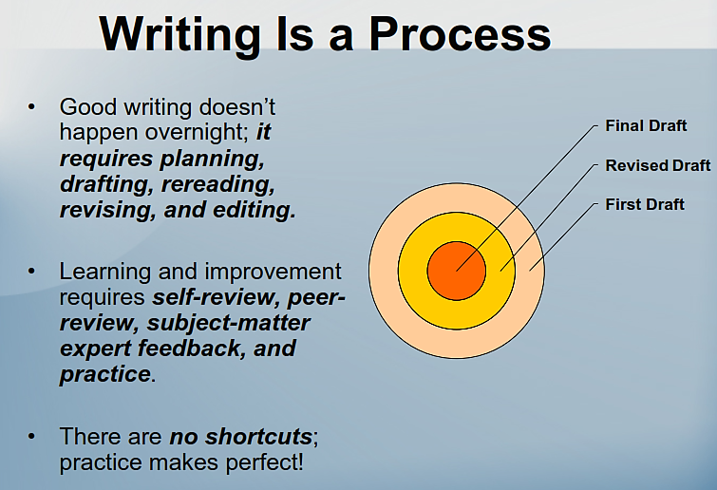
Stage 02: Writing

Slide 28
Conclusions
The writing process
Stage 02 - writing techniques with examples

